Slide 1
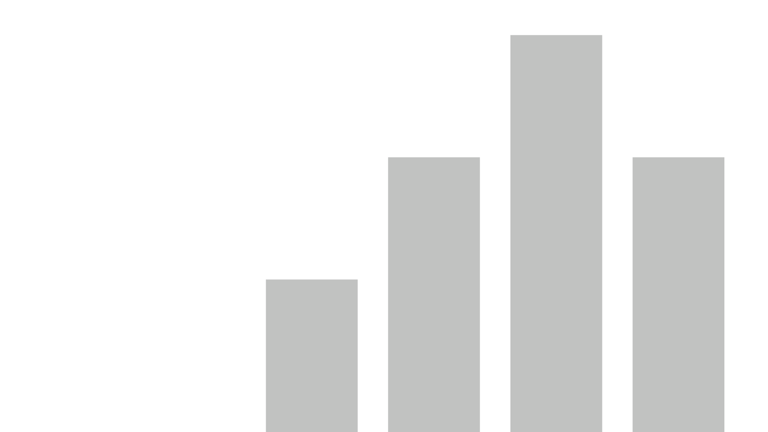


Diversity & Inclusion Dashboard
View in Power BI
Last data refresh:
12/5/2021 5:47:51 AM UTC
Downloaded at:
1/17/2022 12:12:07 PM UTC

Slide 2
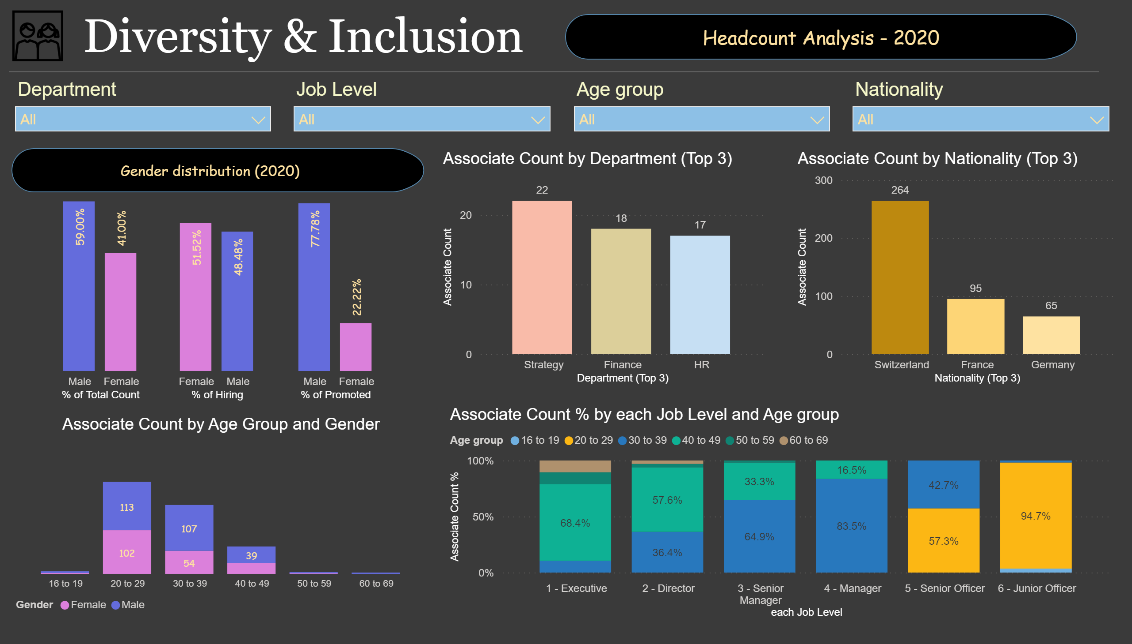
Headcounts Analysis
Notes:
textbox
No alt text provided
basicShape
No alt text provided
image
No alt text provided
Associate Count by Gender (2020)
No alt text provided
Hires by Gender (2020)
No alt text provided
Promotion by Gender (2020)
No alt text provided
shape
No alt text provided
Associate Count by Age Group and Gender
No alt text provided
slicer
No alt text provided
slicer
No alt text provided
slicer
No alt text provided
slicer
No alt text provided
hundredPercentStackedColumnChart
No alt text provided
columnChart
No alt text provided
columnChart
No alt text provided
shape
No alt text provided

Slide 3
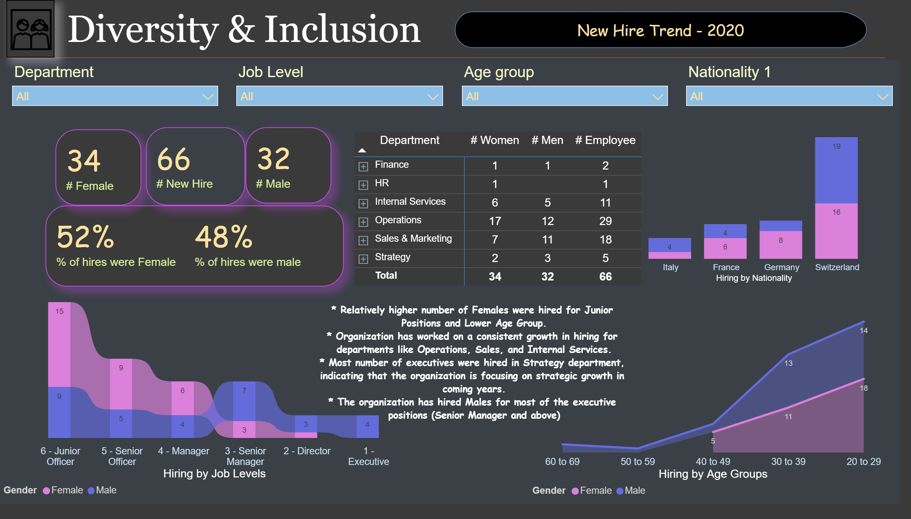
Hiring Trend
Notes:
textbox
No alt text provided
basicShape
No alt text provided
stackedAreaChart
No alt text provided
ribbonChart
No alt text provided
Hiring Trend by Department
No alt text provided
multiRowCard
No alt text provided
multiRowCard
No alt text provided
multiRowCard
No alt text provided
multiRowCard
No alt text provided
columnChart
No alt text provided
slicer
No alt text provided
slicer
No alt text provided
slicer
No alt text provided
slicer
No alt text provided
textbox
No alt text provided
basicShape
No alt text provided
image
No alt text provided
shape
No alt text provided

Slide 4
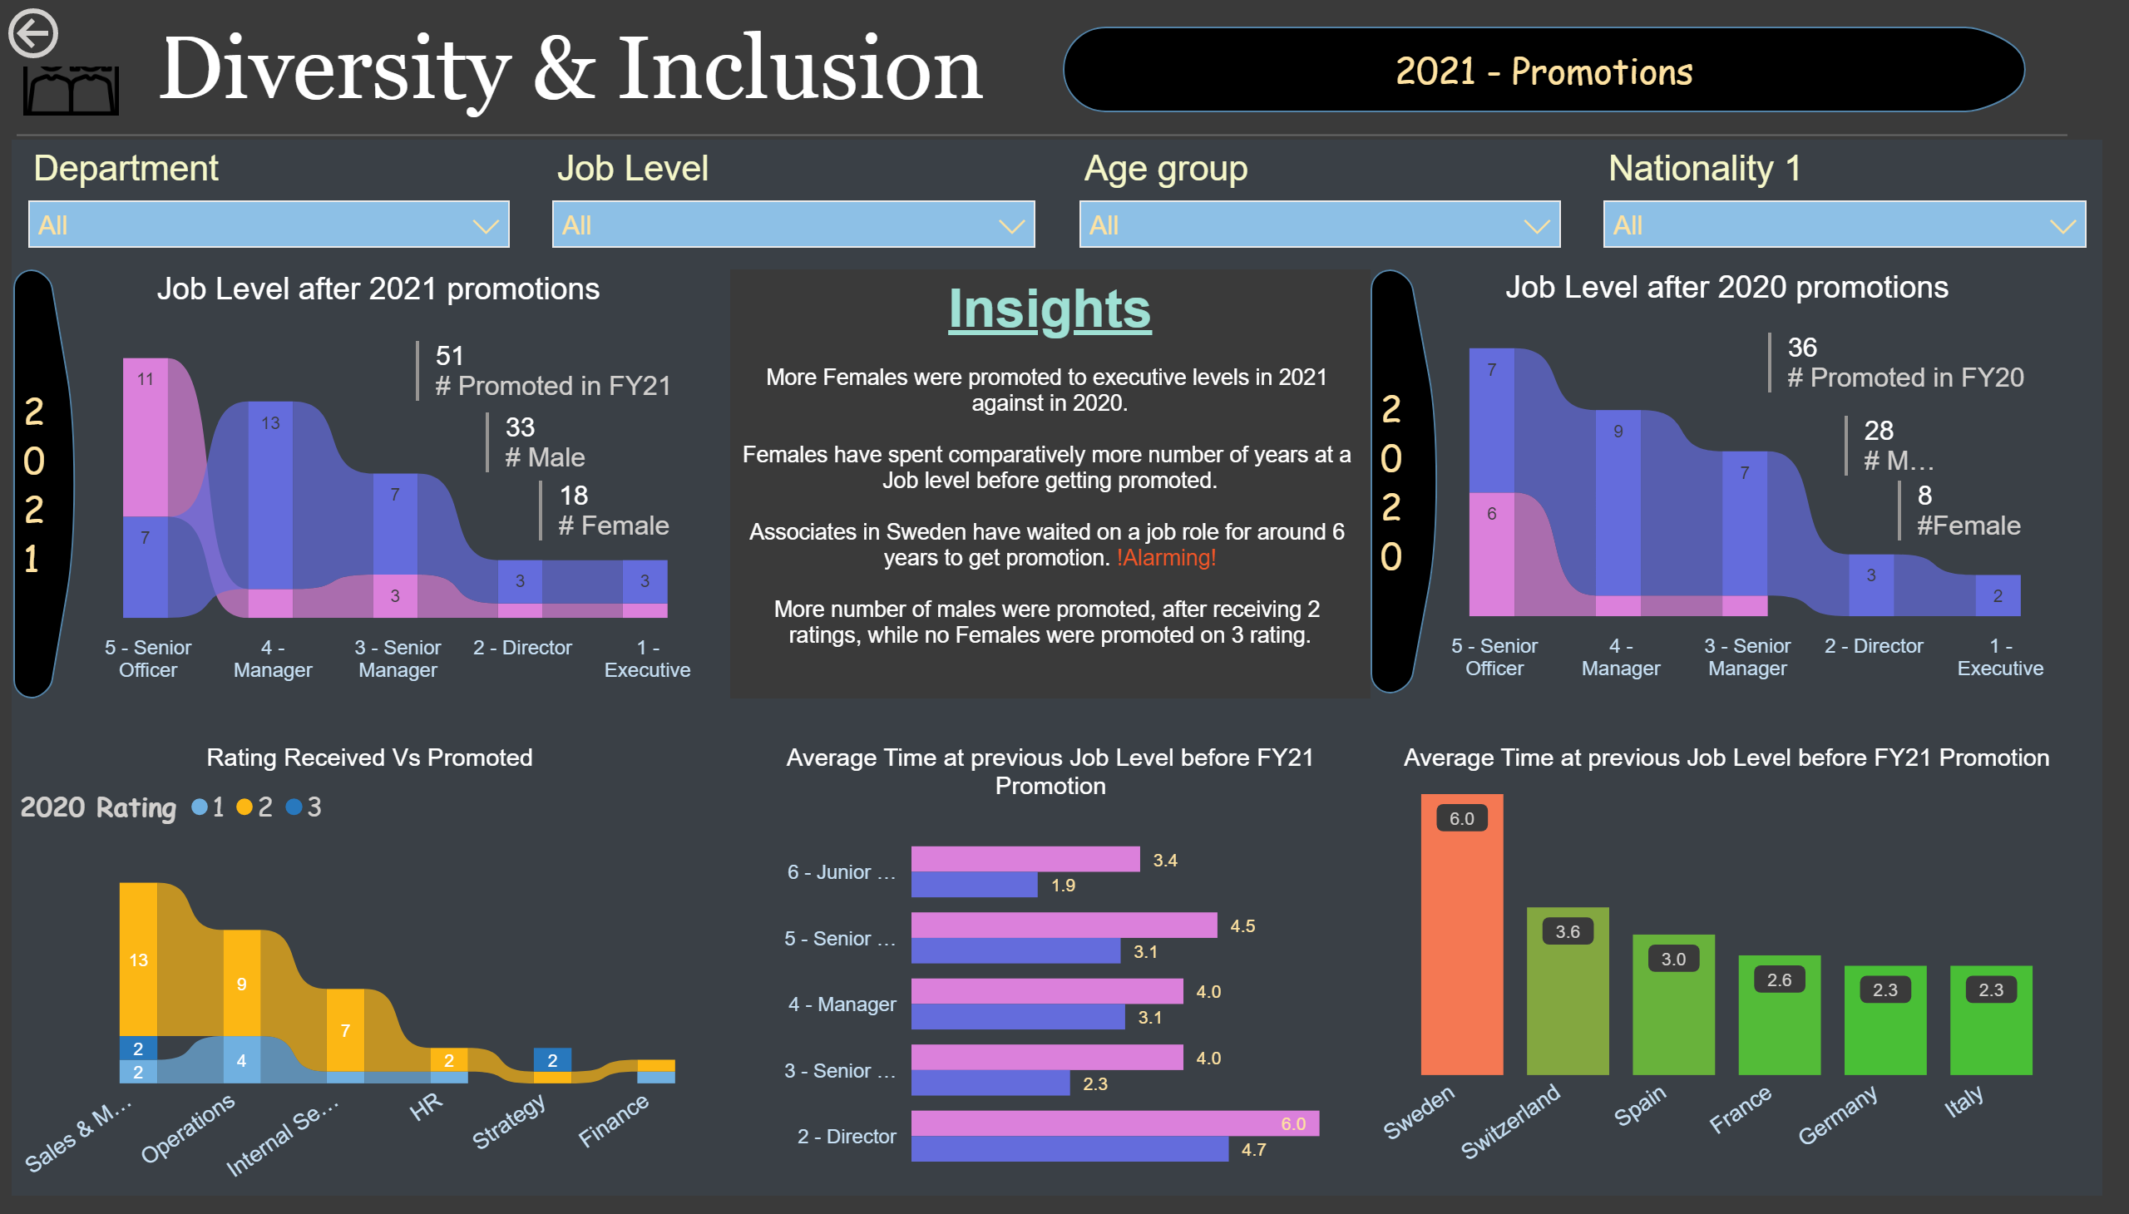
Promotion Trend
Notes:
textbox
No alt text provided
basicShape
No alt text provided
image
No alt text provided
slicer
No alt text provided
slicer
No alt text provided
slicer
No alt text provided
slicer
No alt text provided
textbox
No alt text provided
shape
No alt text provided
multiRowCard
No alt text provided
multiRowCard
No alt text provided
multiRowCard
No alt text provided
Job Level after 2020 promotions
No alt text provided
multiRowCard
No alt text provided
multiRowCard
No alt text provided
multiRowCard
No alt text provided
shape
No alt text provided
Job Level after 2021 promotions
No alt text provided
Rating Received Vs Promoted
No alt text provided
Average Time at previous Job Level before FY21 Promotion
No alt text provided
Average Time at previous Job Level before FY21 Promotion
No alt text provided
actionButton
No alt text provided
shape
No alt text provided

Slide 5
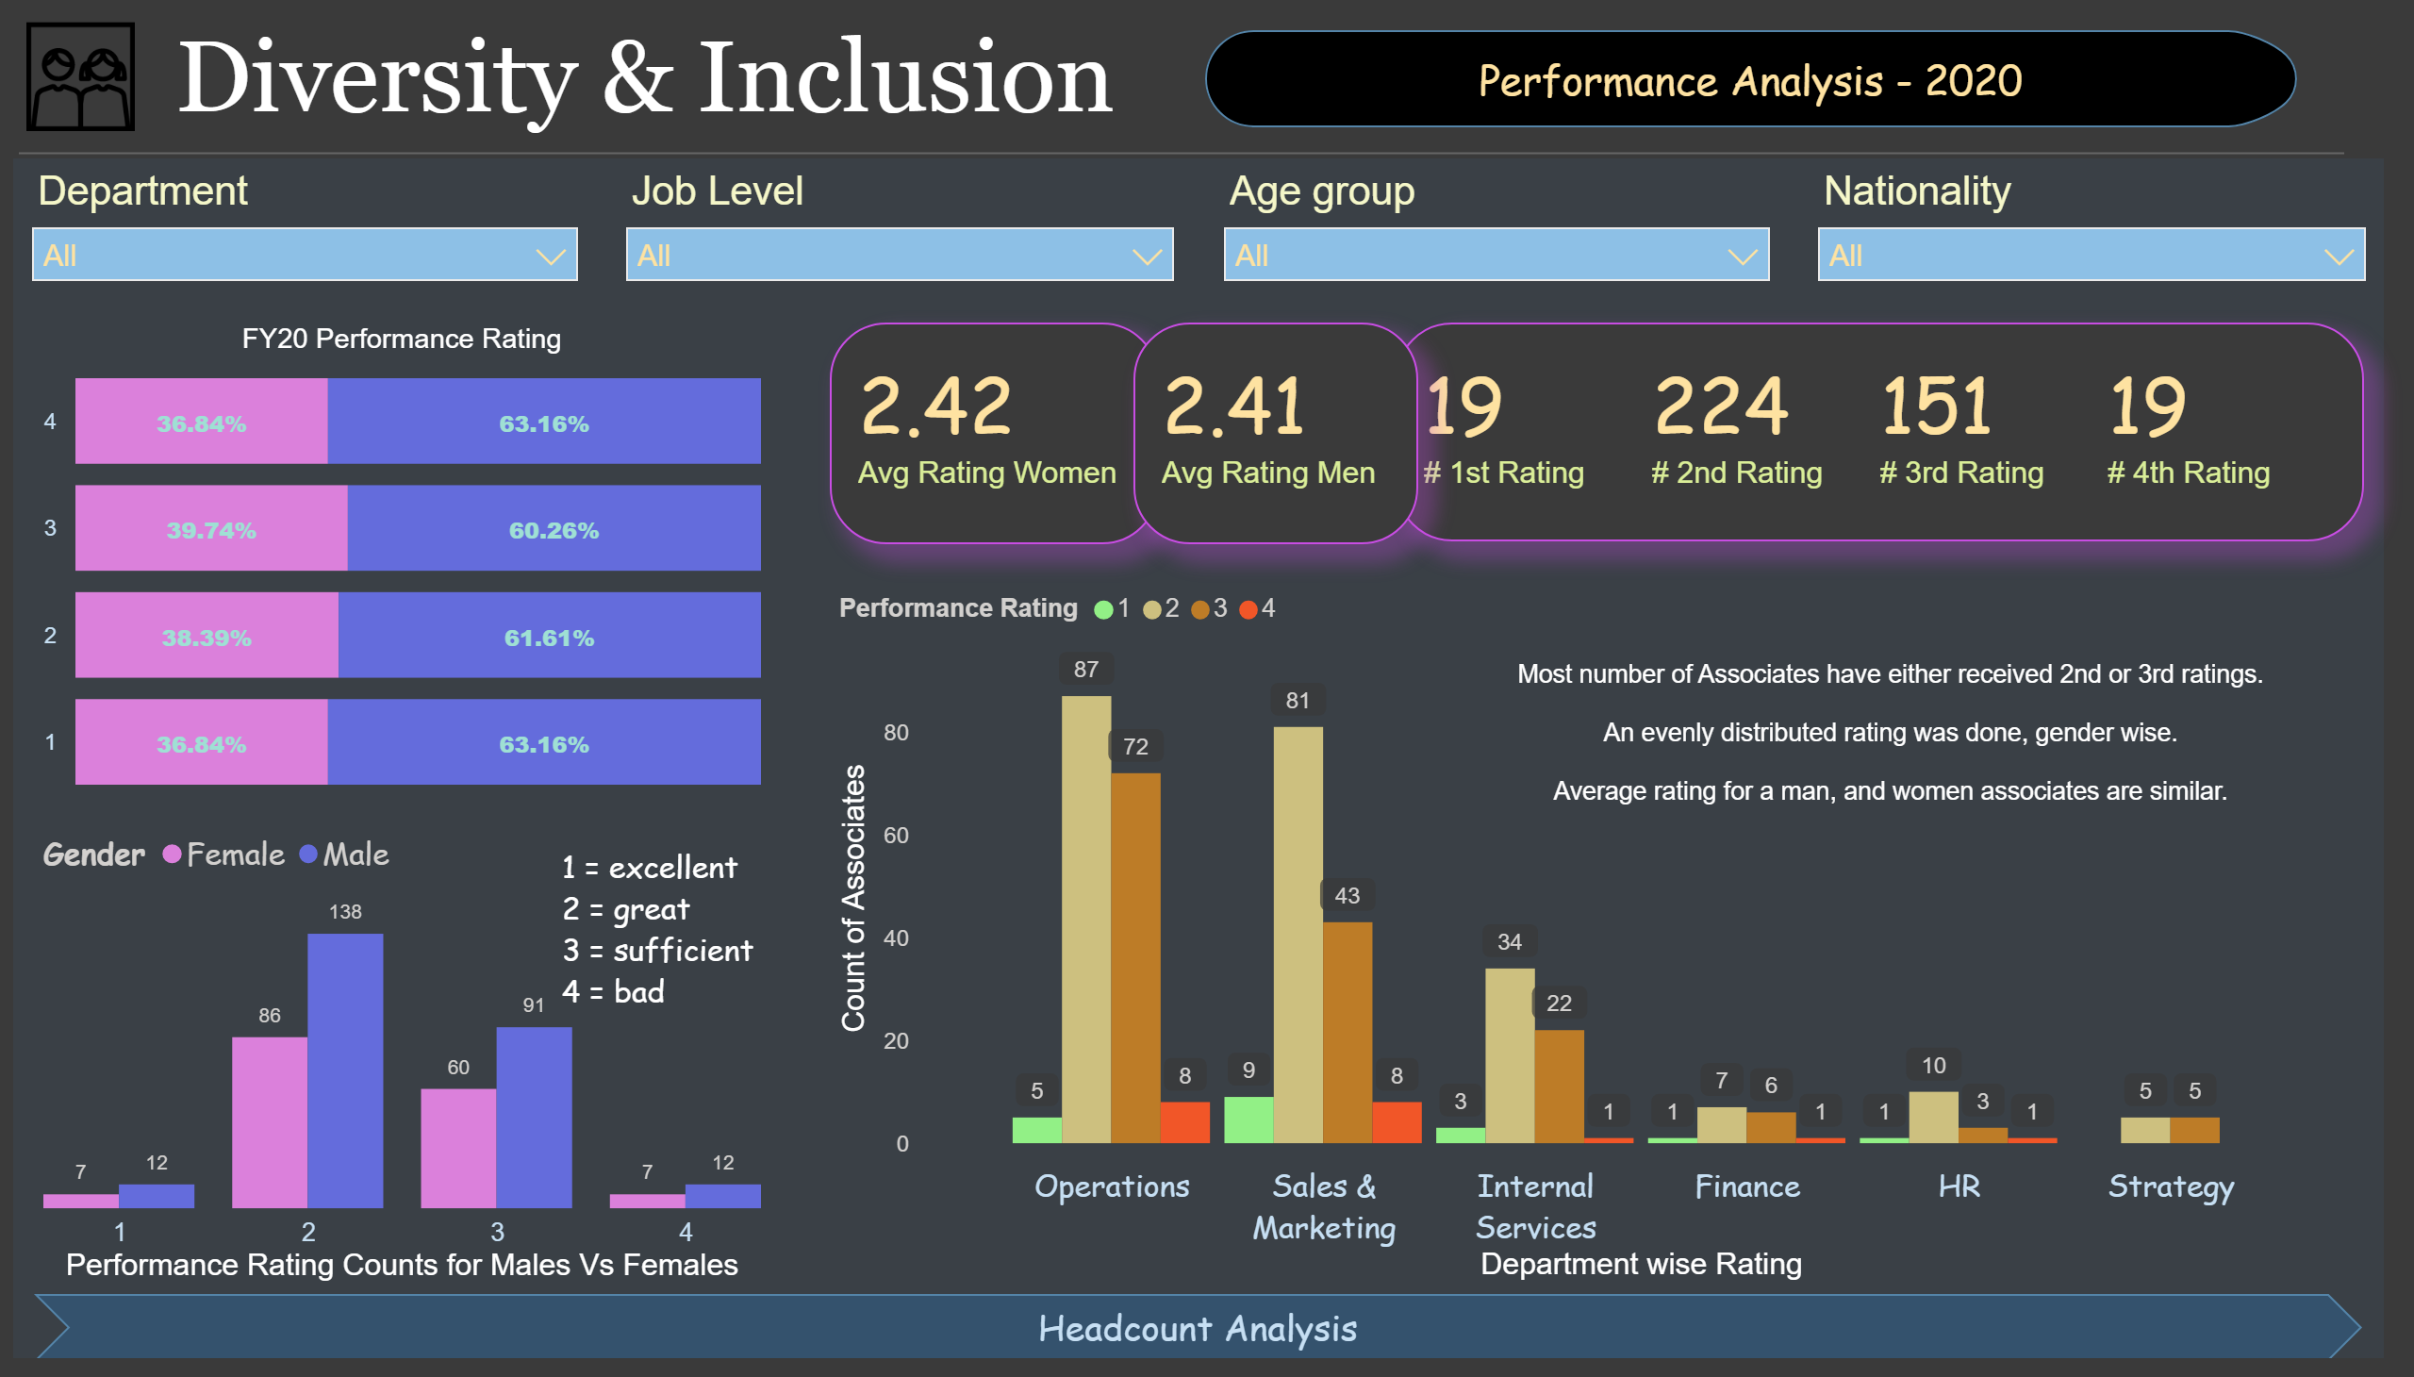
Performance Variables
Notes:
textbox
No alt text provided
basicShape
No alt text provided
shape
No alt text provided
textbox
No alt text provided
Female
No alt text provided
lineClusteredColumnComboChart
No alt text provided
Female
No alt text provided
FY20 Performance Rating
No alt text provided
FY20 Performance Rating
No alt text provided
textbox
No alt text provided
clusteredColumnChart
No alt text provided
slicer
No alt text provided
slicer
No alt text provided
slicer
No alt text provided
slicer
No alt text provided
image
No alt text provided
shape
No alt text provided

Slide 6
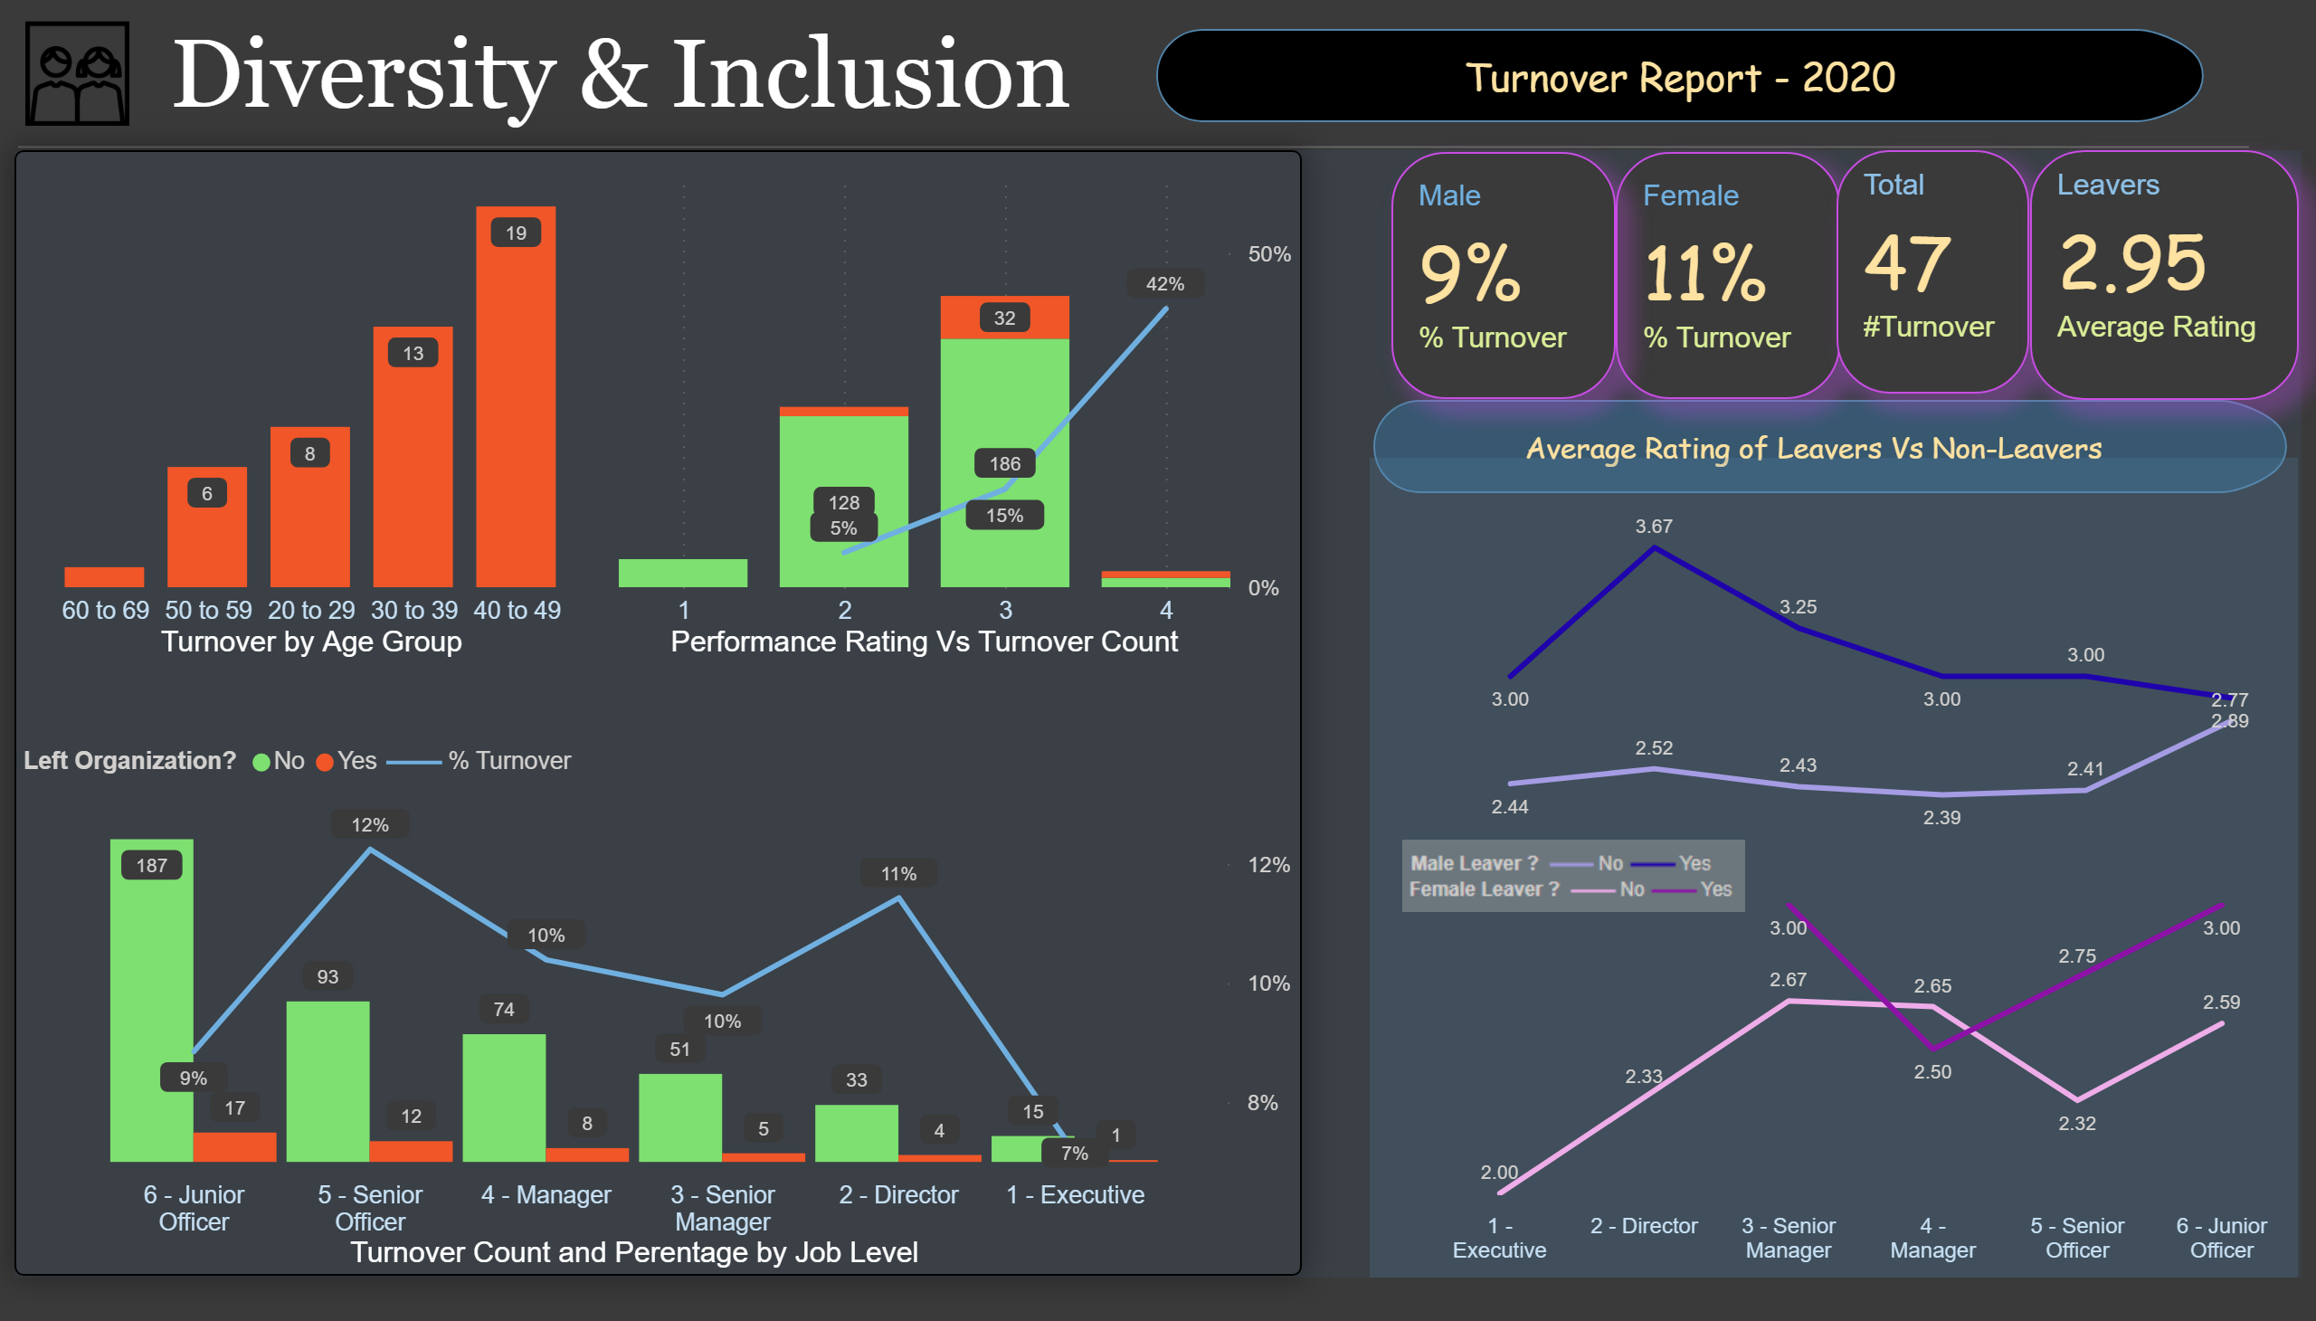
Turnover Trend
Notes:
textbox
No alt text provided
basicShape
No alt text provided
image
No alt text provided
image
No alt text provided
Average Performance Rating of Leavers vs non-Leavers (MEN)
No alt text provided
Average Performance Rating of Leavers vs non-Leavers (WOMEN)
No alt text provided
shape
No alt text provided
Leavers
No alt text provided
Total
No alt text provided
multiRowCard
No alt text provided
multiRowCard
No alt text provided
lineStackedColumnComboChart
No alt text provided
Average Performance Rating of Leavers vs non-Leavers (WOMEN)
No alt text provided
lineStackedColumnComboChart
No alt text provided
shape
No alt text provided
shape
No alt text provided

